Slide 1
HCL HACKATHON
TEAM - SNOWCREWS
USECASE: HEALTHCARE ANALYTICS & PATIENT INSIGHTS

Slide 2
HCL HACKATHON
TEAM - SNOWCREWS
USECASE: HEALTHCARE ANALYTICS & PATIENT INSIGHTS
USECASE DIAGRAM

Slide 3
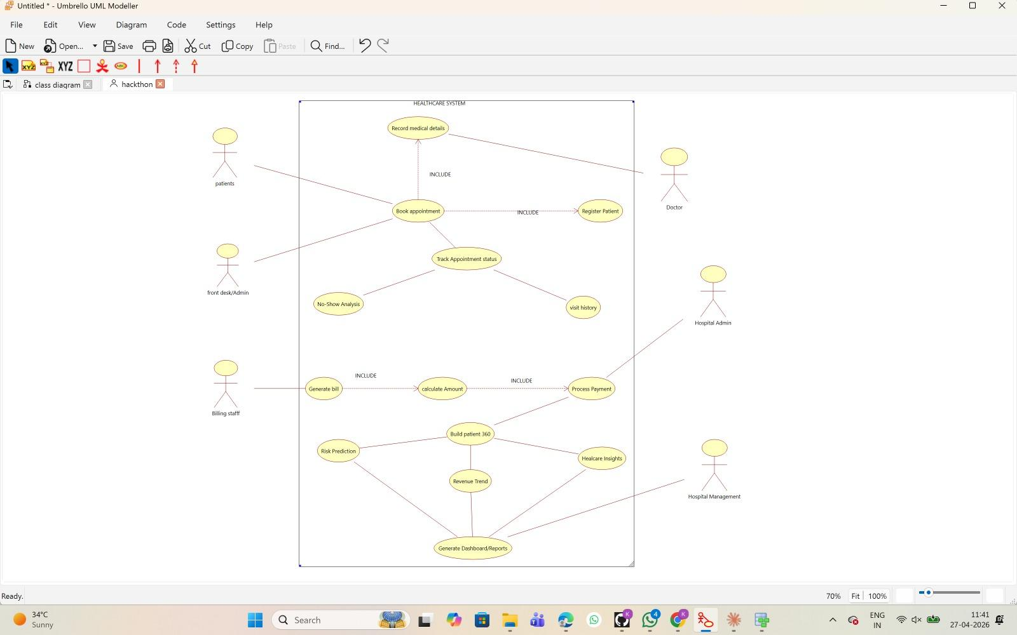

Slide 4
HCL HACKATHON
TEAM - SNOWCREWS
USECASE: HEALTHCARE ANALYTICS & PATIENT INSIGHTS
FLOW DIAGRAM

Slide 5
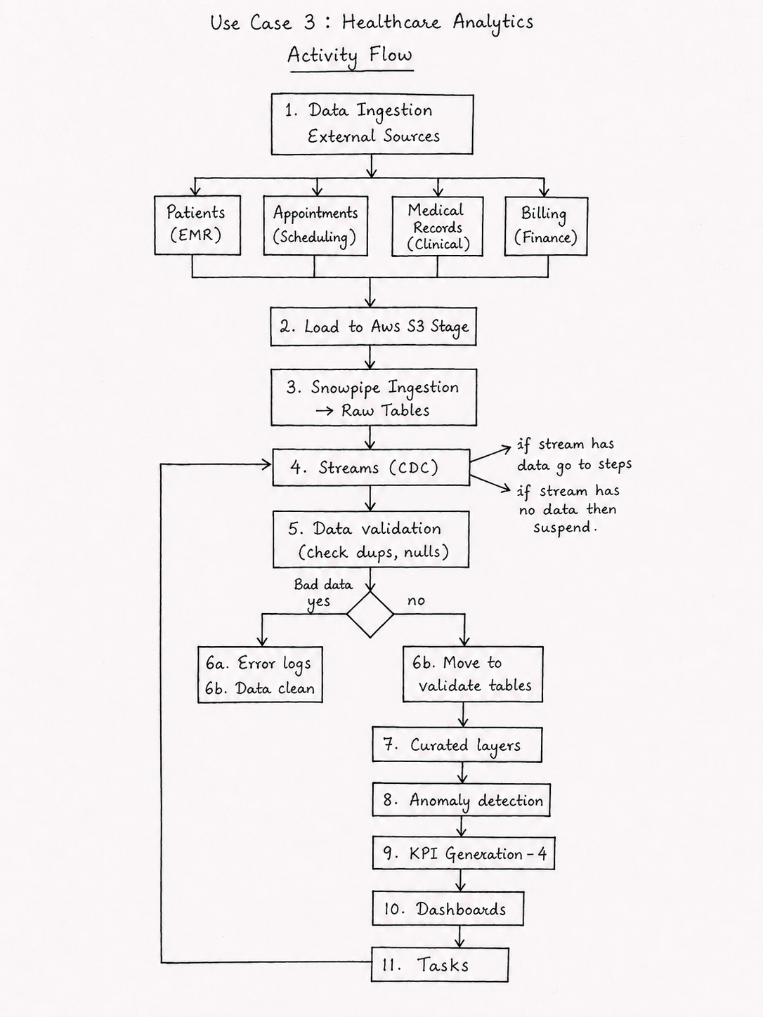

Slide 6
HCL HACKATHON
TEAM - SNOWCREWS
USECASE: HEALTHCARE ANALYTICS & PATIENT INSIGHTS
STAR SCHEMA DESIGN
DATA MODELER - RELATIONAL

Slide 7
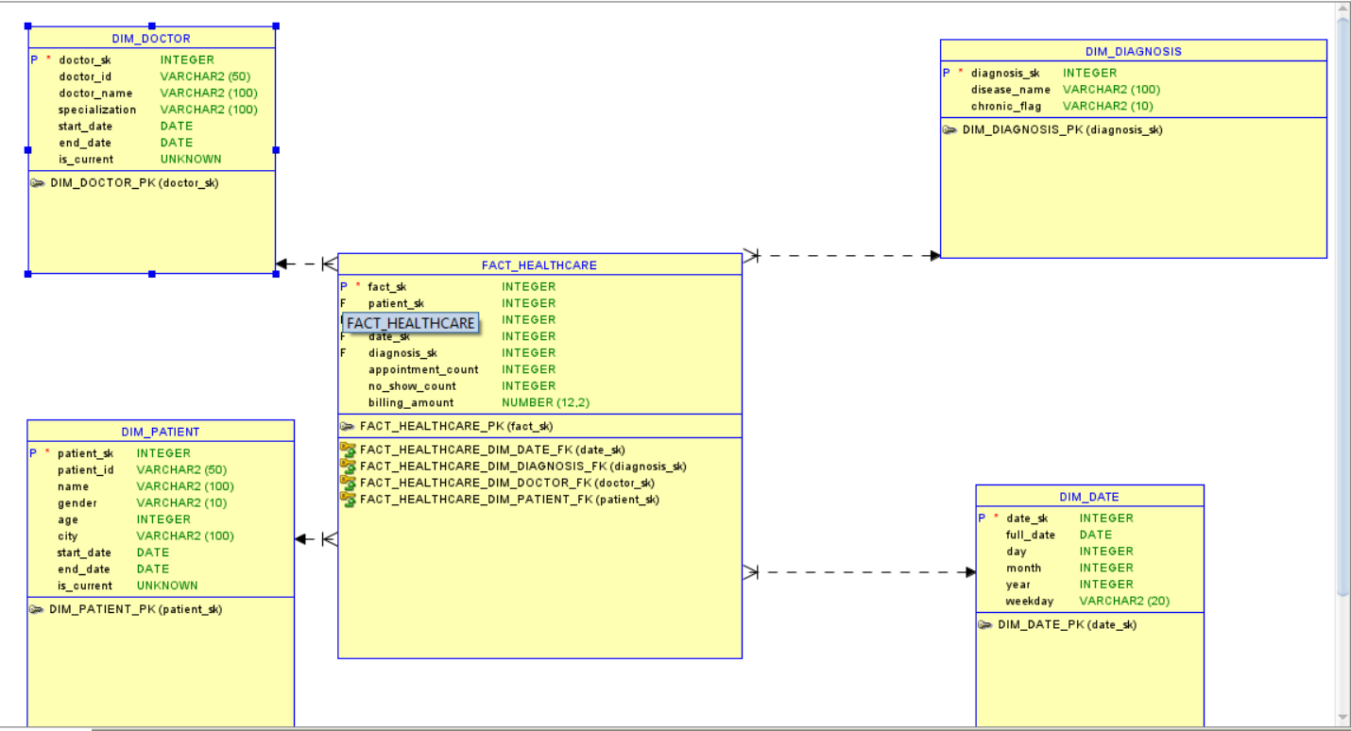

Slide 8
HCL HACKATHON
TEAM - SNOWCREWS
USECASE: HEALTHCARE ANALYTICS & PATIENT INSIGHTS
STAR SCHEMA DESIGN
DATA MODELER - LOGICAL

Slide 9
